Slide 1

Covid-19 Heath Workforce Estimator User Guide
Version 3.0
3rd May 2020
Notes:
This is the user guide for the Covid-19 Health Workforce Estimator, available as a Microsoft Excel spreadsheet.

Slide 2
What is the purpose of this tool?
The Health Workforce Estimator (HWFE) tool provides, based on either projected or required numbers of cases:
An estimate of the number of each type of health worker required per day to treat Covid-19 cases by level of severity (mild, moderate, severe and critical)
Analysis of current capacity and likely surge requirements across health facilities and work units, highlighting potential mismatches
Visualizations of the impact of the surge on workforce groups
Notes:
The purpose of the tool is to help you understand your current health workforce, the capability for dealing with Covid-19 patients, and what needs to change to meet a predicted surge in cases.
It won’t provide exact answers, because every member state has a different health system, with different processes, workforce groups and skills mix. But it will help you to think about what is needed, and where to concentrate your efforts.
The spreadsheet is protected; all areas for user input are highlighted in yellow.

Slide 3
What does it address?
Includes:
Excludes:
Estimated workforce to care for COVID-19 patients
4 Different levels of severity: Mild, Moderate, Severe and Critical
Screening and triage
User-defined healthcare facilities and work units
User-defined staff groups & numbers at each healthcare facility and work unit
Horizontal and vertical substitution (role or task sharing)
Estimated times for staff to complete necessary procedures/activities per patient per day
Forecasting future Covid-19 cases (but can input projection data)
Staff absences, e.g. from COVID-19 infections or quarantine
Representation of uncertainty
3
Covid-19 Workforce Estimator Guide
Notes:
This shows what the tool does and does not do. The tool doesn’t cover everything, and some areas are currently out of scope but may be considered for future releases.
Although this is not a forecasting tool, it can be linked it to the output from predictive models, in terms of the number and severity of Covid-19 cases over time.
It is currently set up to link to the Adappt Surge Planning Support Tool, should you wish to import the data. This is manual process and will require you to run both tools.

Slide 4
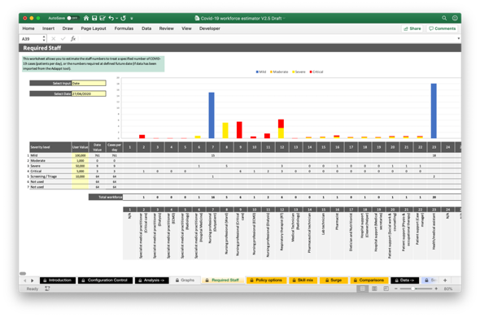
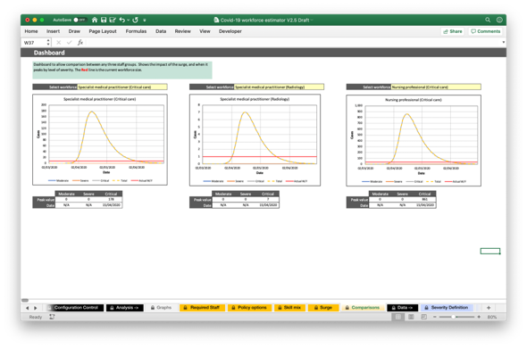
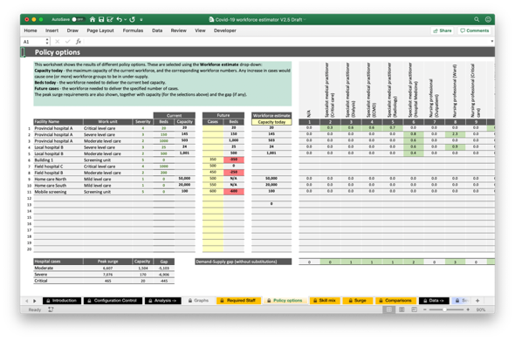
Health Workforce Estimator Tool
The tool allows you to:
Estimate the workforce numbers needed to treat a required number of Covid-19 cases per day (by level of severity)
Understand the current capacity per day of your existing workforce across different facilities and work units
See what workforce numbers are required to meet a future surge, and what groups are in under or over supply
Visualize the impact of the surge on different workforce groups, when the peak happens, and the gap between current and future health workforce requirements
Notes:
The tool allows you to address several important questions:
What staff groups and numbers are needed to achieve a required number of Covid-19 patients per day?
What is the current capacity of my workforce?
What staff groups and/or health facilities/work units are under most pressure?
What is the impact of the surge on different workforce groups?
How much do different workforce groups needs to scale up to meet the surge?
In other words, to better understand the gap between what you have now, what you will need in the future, and the best ways to close the gap.

Slide 5
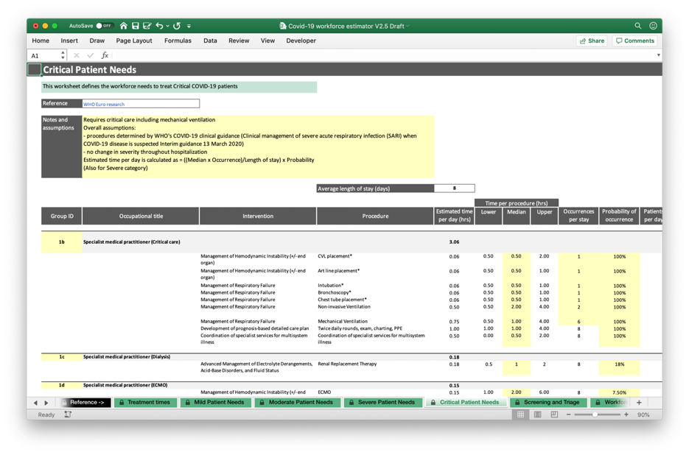
Review the Reference data
The reference data for the calculations is in the Mild, Moderate, Severe and Critical Patient Needs worksheets. The Workforce Descriptions worksheet provides the definition, and the references to papers and journals are the in the Journal Papers worksheet.
The data is from WHO Euro research, and represents typical times for a European country, although these vary widely between countries.
The reference data is password protected.
Notes:
The Reference data used in the calculations is provided for review. This is important so that you can see the underlying assumptions and calculations that have been made.

Slide 6
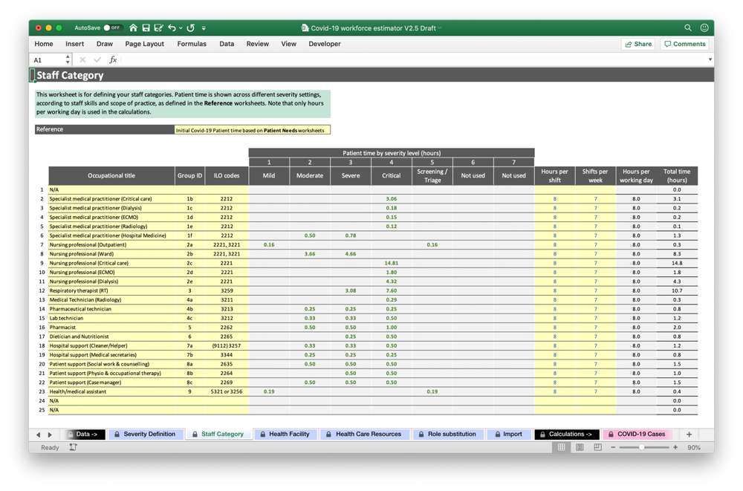
Define your Staff Groups
Go to the Staff Category worksheet
To use the pre-populated data, you only need to check the hours per working day. Specify them using hours per shifts and shifts per day
You can define your own staff groups if you have relevant data for your member state
You must then define the procedures and treatment times (see next slide). The patient times will show the values once this is done
The Group ID should be unique to each staff group
Notes:
The tool is populated with information on staff groups and the interventions, procedures and times required to treat a Covid-19 patient over one day, based on WHO Europe research.
Go to the Staff Groups worksheet.
If you wish to use the pre-populated data, then the only thing you need to check is the hours per working day.
If you wish to define your own staff groups, then each must have a unique identifier which links to the data in the Reference worksheets. The worksheets after the Reference tab will then need to be updated with revised procedures and times. Only do this if you have access to relevant data on Covid-19 treatments.
Patient time per 24hrs (green) is from the Reference worksheets, so these need to be completed (see next slide).
The calculations use hours per working day. If you are not using Shifts per week and Hours per shift, you can set Shifts per week to 7 and Hours per shift to the desired number of Hours per working day.
Update staff group descriptions in Workforce descriptions if required.

Slide 7
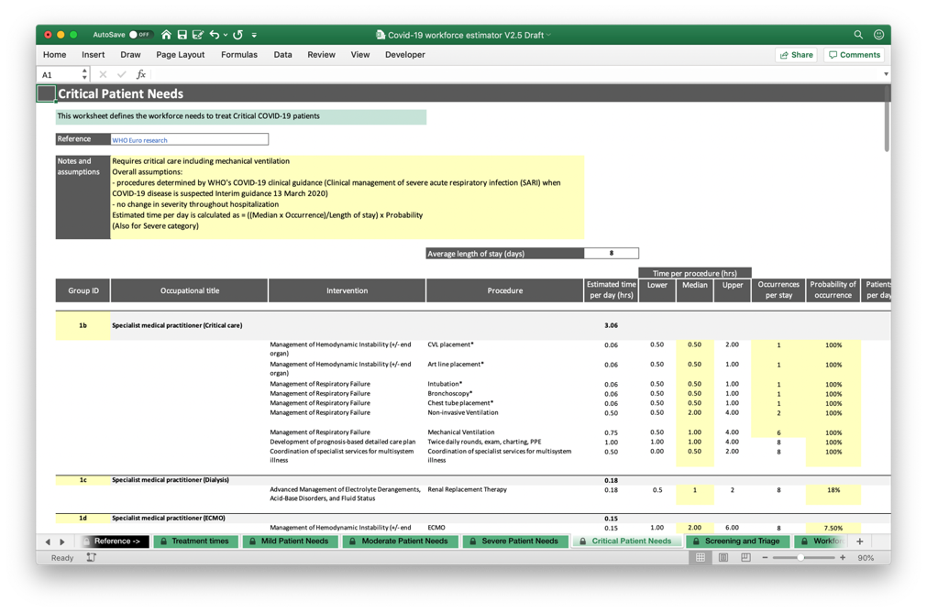
Define your Patient Needs (optional)
Go to the Reference worksheets (Mild, Moderate, Severe and Critical, plus Screening and Triage
For each workforce defined in the Staff Category worksheet, specify the interventions, procedures and times
The Group ID must be the same to link the data
Check the length of stay
Make sure that where there are several procedures, these are summed correctly
When completed go to the Staff Category worksheet to check the times
Notes:
Updating these worksheets needs to be done carefully.
The worksheets are locked. Please contact us for the Password (see the Further Information slide).
Data needs to be provided for all the staff groups, across all levels of severity from Mild to Critical.
Check that the average length of stay is correct and revise if needed. This should be based on evidence, as should all the data.
Mild and Moderate patient needs assume that all procedures are done once per stay. The Median time is used (this must be Column F). The Group ID (Column B) must match the Group ID given in the Staff Category worksheet, for each staff group. If this is not done the data will not link correctly.
Severe and Critical patient procedures can be repeated several times in each patient stay (Occurrences per stay) and may not always be done (Probability of occurrence). As above, Columns F and B must contain the required values.
Screening and Triage is updated in the same way as for Mild and Moderate groups.

Slide 8
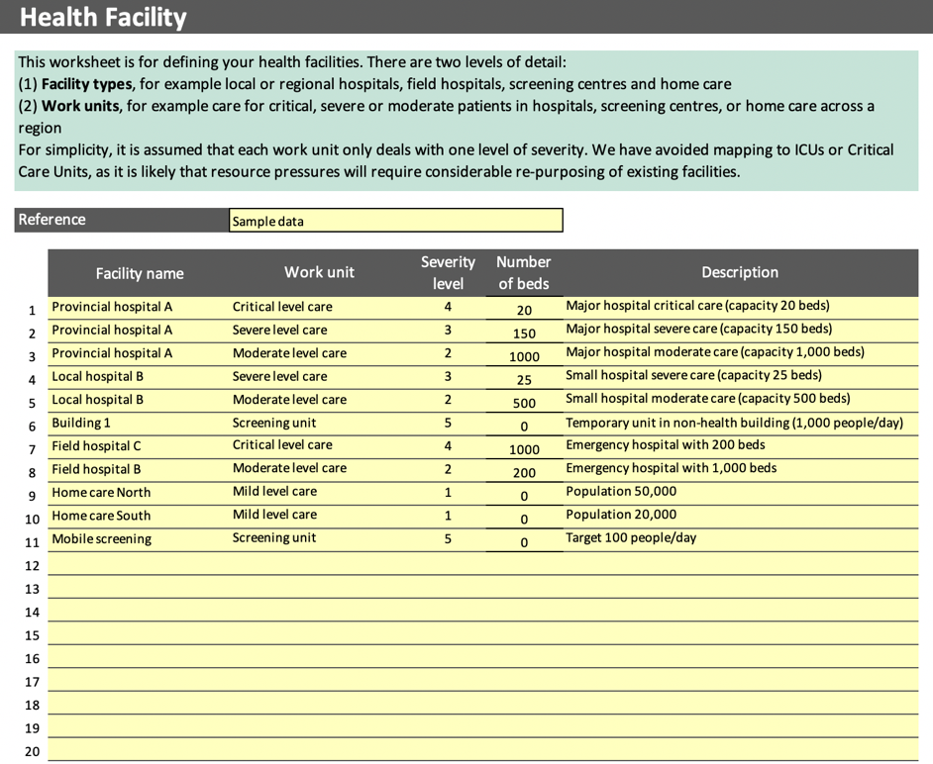
Define your Health Facilities
Go to the Health Facility worksheet
Define your facility names and work units. These are simply names that make sense to you, and can be local, regional or national as required
Specify the severity level for each facility/unit. This is the level of treatment for patients, as defined in the Severity Definition worksheet
Specify the number of beds at each facility, if relevant
Provide a description if required
Notes:
Go to the Health Facility worksheet.
You can define up to 20 health facilities and work units, at any level of scale, for example national, regional or local. These are simply health care locations with staff, which you define, and each of which deals with one kind of COVID-19 case, from mild to critical. Screening and triage is also included. Note that these can be work units that you plan to create, as well as those you have now.
Each work unit must have a defined severity level and is assumed to treat only these cases. Beds numbers can also be input (not relevant for screening or mild level care).
You can also include a description if you wish.
If more than 20 work units are required, then separate copies of the tool could be created, for example one spreadsheet per region.

Slide 9
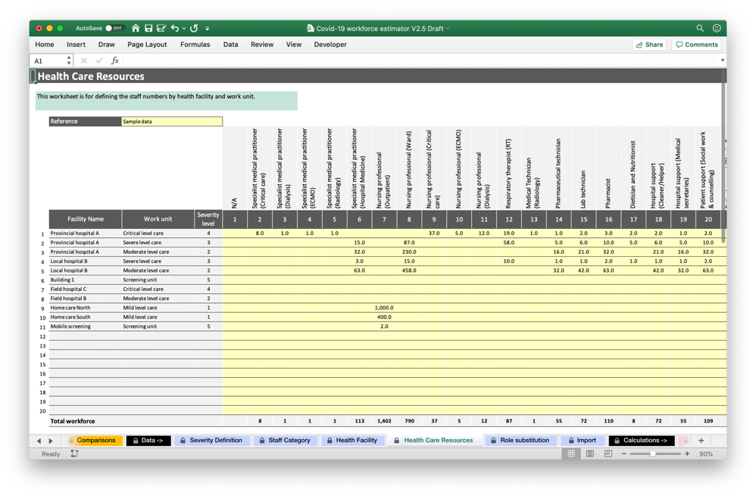
Define your Health Care Resources
Go to the Health Care Resources worksheet
Your Staff Categories have already been defined
Input the number of staff, by staff group, for each facility and unit. This is in Full Time Equivalents (FTE)
Use the totals at the bottom and right-hand side (not shown) of the spreadsheet to check that the numbers are correct
Go back to the Staff Groups worksheet to check the data is correct by staff group
Notes:
Go to the Health Care Resources worksheet.
For each of the health facilities and work units that you have just defined, and for each of the staff groups, define the number of staff as Full-Time Equivalents (FTE).
Note that as each facility/unit is dealing with a specific level of severity, you should only define those workforce groups that are required. The worksheets following the Reference tab define these workforce groups.

Slide 10
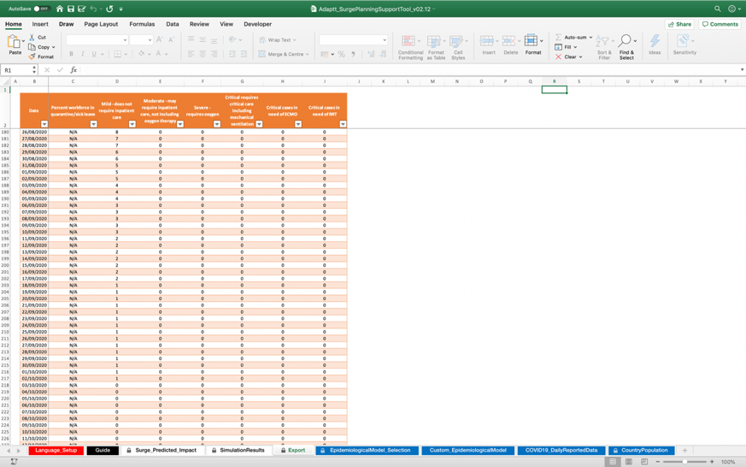
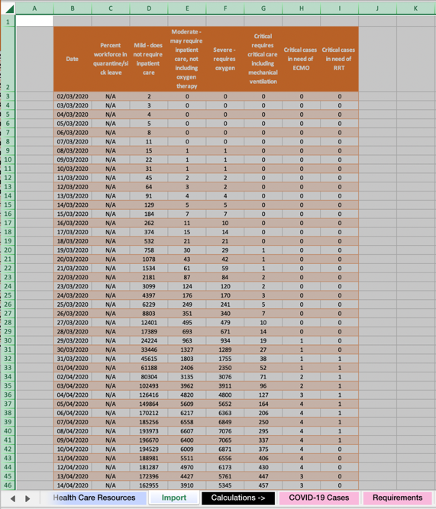
Import Adappt data (optional)
You can import data from the Adappt tool. This enables you to do surge workforce planning
Once the tool has been set up to meet your requirements, go to the Export workforce, click the Select All button and copy everything with CTRL+C
Go to the HFWE Import worksheet, click the Select All button and paste everything with CTRL+V
You should now have all the data copied across
Notes:
You can input epidemiological data from another model to show how the surge in Covid-19 cases might impact the workforce, and what changes need to be made to meet the surge.
This is done by simply copying and pasting data between the tools. You simply select and copy all the data in the Adappt Export worksheet, and paste to the HWFE Import worksheet. The copied data must not be altered in any way.

Slide 11
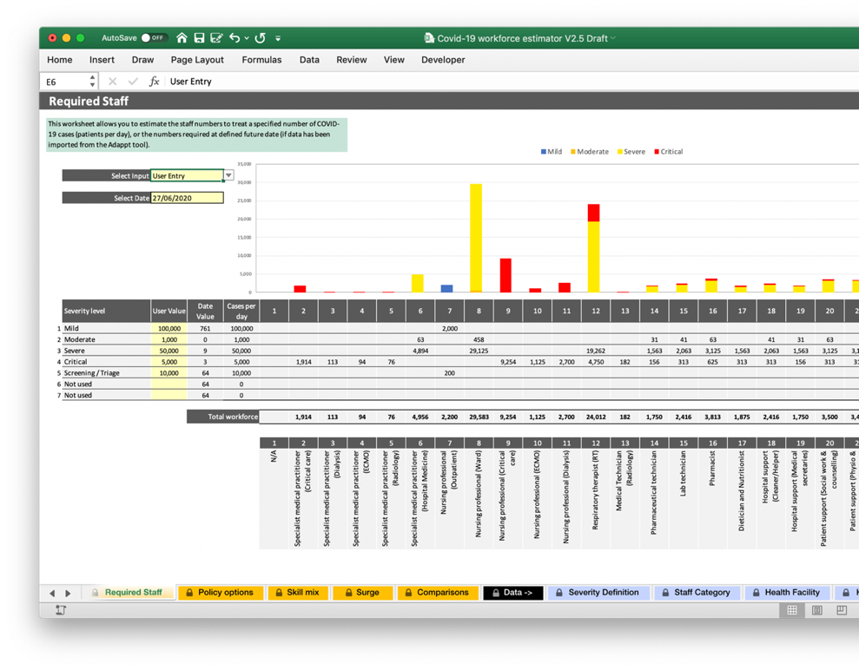
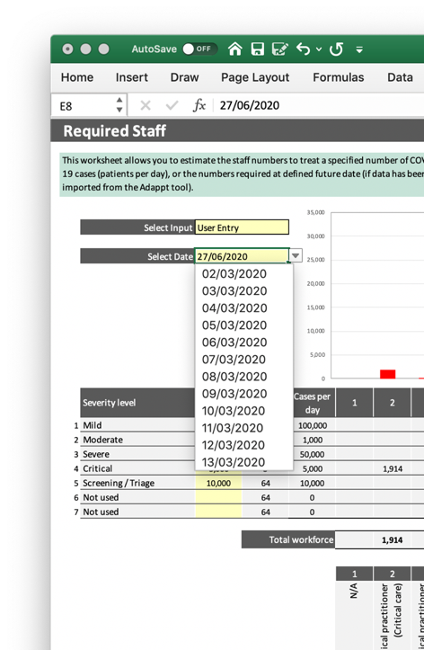
Required Staff worksheet
The Required Staff worksheet helps answer the question:
“What staff groups and numbers are needed to achieve a required number of Covid-19 patients per day?"
Select User Entry to input your required number of patients
Selecting Date rather than User entry allows you to select the projection cases from the Adappt model, assuming this data has been imported
Notes:
Go to the Desired Staff worksheet.
There are two ways that this can be used:
Input the required number of Covid-19 patients or cases, by level of severity, to get the workforce composition and numbers required
If data has been imported from the Adappt tool, select a future data to get the estimated number of cases and workforce required
This worksheet simply provides a workforce estimator. It is not linked to the actual number of staff or where they are.

Slide 12
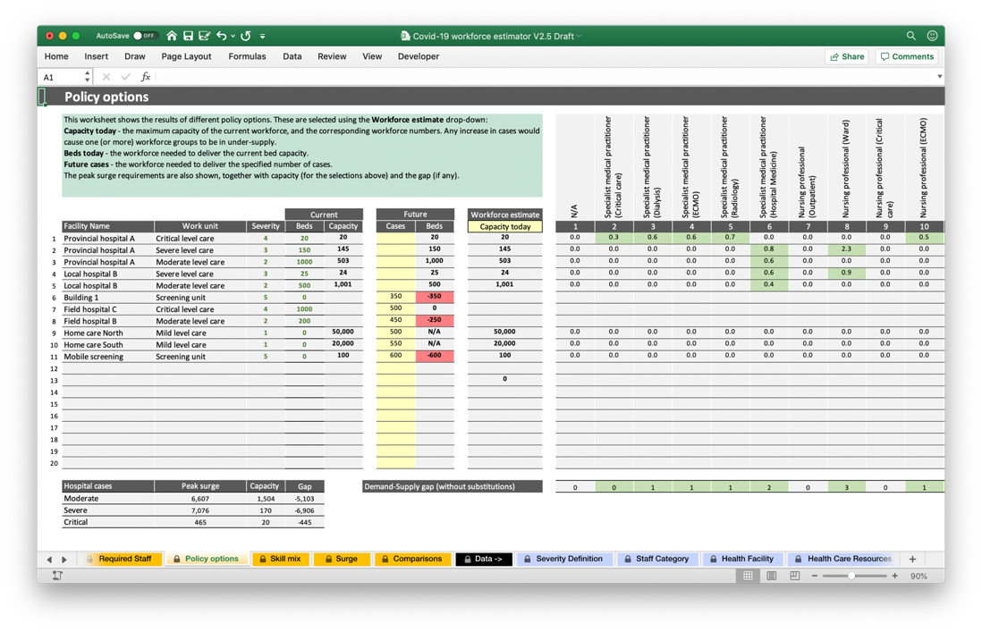
Policy options worksheet
The Policy options worksheet helps answer the questions:
“What is the current capacity of my workforce?”
“What staff groups or health facilities/work units are under most pressure?”
Select Current capacity to see the maximum number of cases for the current workforce
Select Current beds to see the workforce required to reach maximum bed capacity
Select Future cases to see the workforce to meet a required number of cases.
Any under-supply is highlighted in red, over-supply in green
The summary table shows the gap between the capacity and the surge peak
Notes:
Go to the Policy options worksheet.
There are three ways that this can be used:
Select Current capacity to see the capacity of each facility/unit for treating Covid-19 cases. The capacity will be limited by one or more staff groups, whose numbers would need to be increased to treat more patients. The actual numbers are shown on the right.
Select Current beds to see what workforce changes are needed to deliver the maximum bed capacity, i.e. all beds with COVID-19 patients.
Select Future cases to see the workforce required to meet a required number of cases, as defined in the Future cases column. If the number of new cases is set to zero, then the table simply shows current workforce numbers.
The workforce table shows red for under-supply and green for over-supply.
The demand-supply gap assumes no workforce substitutions. If these need to be investigated then the Skill mix worksheet provides a means to model horizontal and vertical substitution.

Slide 13
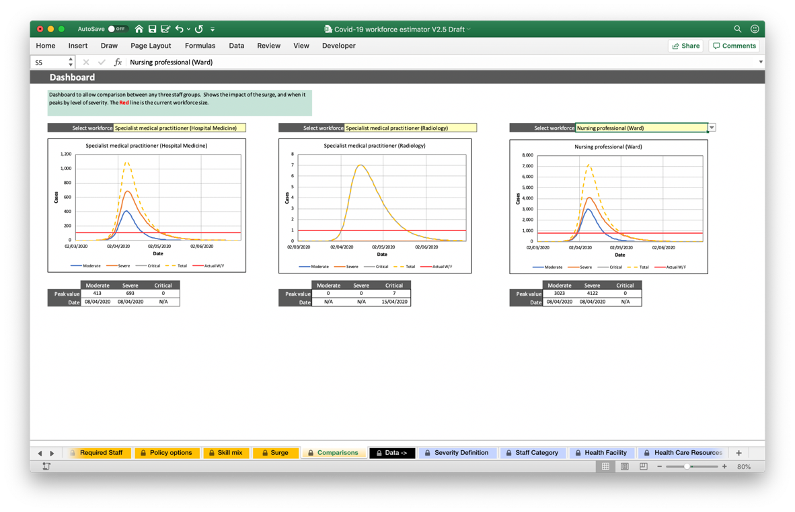
Comparisons worksheet
The Comparisons worksheet helps answer the question:
“What is the impact of the surge on different workforce groups?”
This assumes that Adappt data has previously been input
Select up to three workforces for comparison
The graphs show the numbers required to meet moderate, severe and critical levels of care, and the total
The horizontal red line is the current capacity
The tables show the peak values and the dates they occur
Some workforce groups do not deliver across all severity levels, hence graphs and data may be missing
Notes:
Go to the Comparisons worksheet.
This is a way to compare the impact of the surge on different workforce groups. It show the cases over time, for each selected workforce, and the current maximum capacity as shown by the horizontal red line. It may be helpful in thinking about when the surge is expected, and responses such as skills mix and task sharing.
You can compare up to three workforce groups.
This worksheet does not consider workforce facilities/units, only the current numbers and epidemiological data.

Slide 14
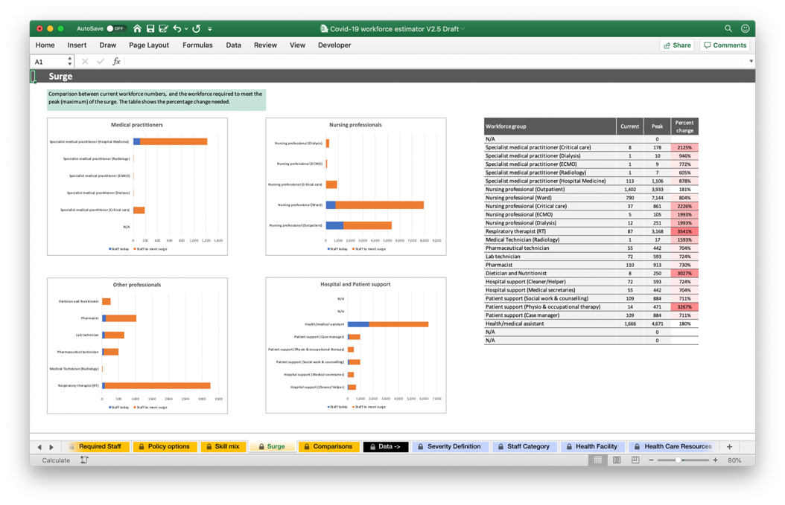
Surge worksheet
The Surge worksheet helps answer the question:
“How much do different workforce groups need to scale up to meet the surge?”
The workforces have been grouped for clarity
Each graph shows the numbers of each workforce today (blue)
It also shows the numbers needed to meet the peak of the surge (orange)
The table on the right shows how much each workforce group needs to increase to meet the peak or surge, as a percentage of the current size
Notes:
Go to the Surge worksheet
This presents the gap between current workforce numbers and the peak surge.
The workforces are displayed in groups for clarity:
Medical practitioners – General medical practitioner, Specialist medical practitioner (Critical care, Dialysis, ECMO, Radiology, Hospital medicine)
Nursing professionals – Outpatient, Ward, Critical care, ECMO, Dialysis
Other professionals – Respiratory therapist, Medical technician (Radiology), Pharmaceutical and Lab technician, Dietician and Nutritionist
Hospital and patient support – Cleaner/Helper, Medical secretaries, Social work & counselling, Physio & occupational therapy, Case Manager, Health/Medical assistant
The percentage change required to meet the estimated surge is shown on the right.

Slide 15
Skill mix
The spreadsheet allows you to investigate skill mix (or role substitution) in order to supplement an existing workforce group. Two kinds are supported:
Horizontal substitution – where one workforce group replaces a similar workforce group at the same level of skill. For example, recently retired doctors and nurses could return to work to support existing doctors and nurses. All their time is spent in support.
Vertical substitution – where one workforce supports one at a higher skill level by performing some (but not all) of their tasks. Only part of their time is spent in support.
These staff will need supervision, so a simple model is used of how many people one existing staff member can supervise. The more support that is needed, the smaller the number that can be supervised.
Notes:
Skill or role substitution can be used to supplement a workforce group, either to reduce shortages, or to provide support so that the group being supported can, in turn, support another group at higher level of skill.

Slide 16
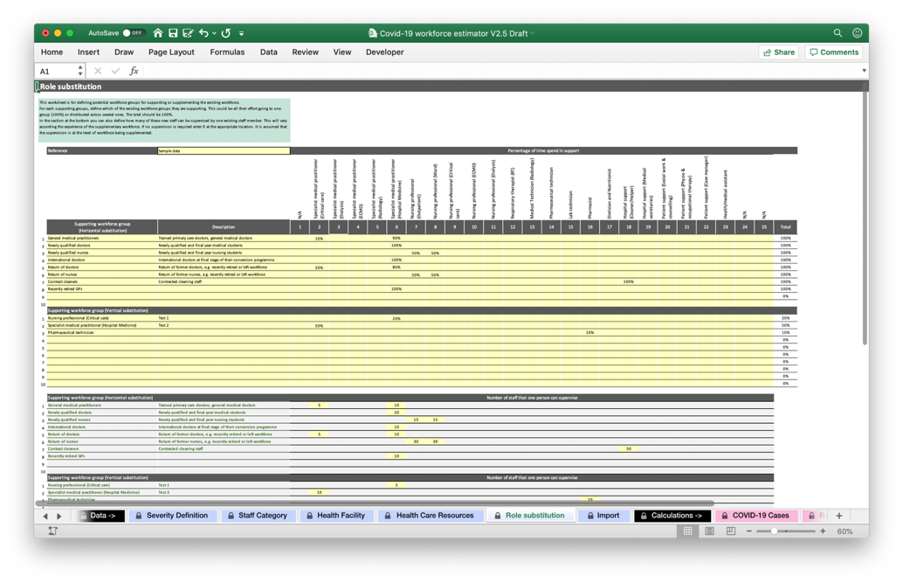
Role substitution worksheet
Go to the Role substitution worksheet
Input the horizontal workforce groups and where their time goes in support. This should sum to 100%
Repeat for the vertical workforce groups. Only part of their time in spend in support.
Specify how many new staff an existing staff member can supervise. The areas for data entry will automatically highlight.
16
Covid-19 Workforce Estimator Guide
Notes:
Go to the Role substitution worksheet
Any horizontal workforce groups can be defined. These are new groups from outside the health system, for example those recently retired, and newly qualified and final year students
Vertical workforce groups are those that already exist in the system, hence they have the same names. They are “acting up”, that is working to support a workforce at a higher skill level. We assume acting down is not needed.
Define how many of these supporting staff can be supervised by one existing staff member at the level they are supporting. This will vary according to the experience of the supporting workforce. This means that 100 supporting staff, where one existing staff member is needed to supervise five of them, will provide a net number of 80 additional staff.

Slide 17
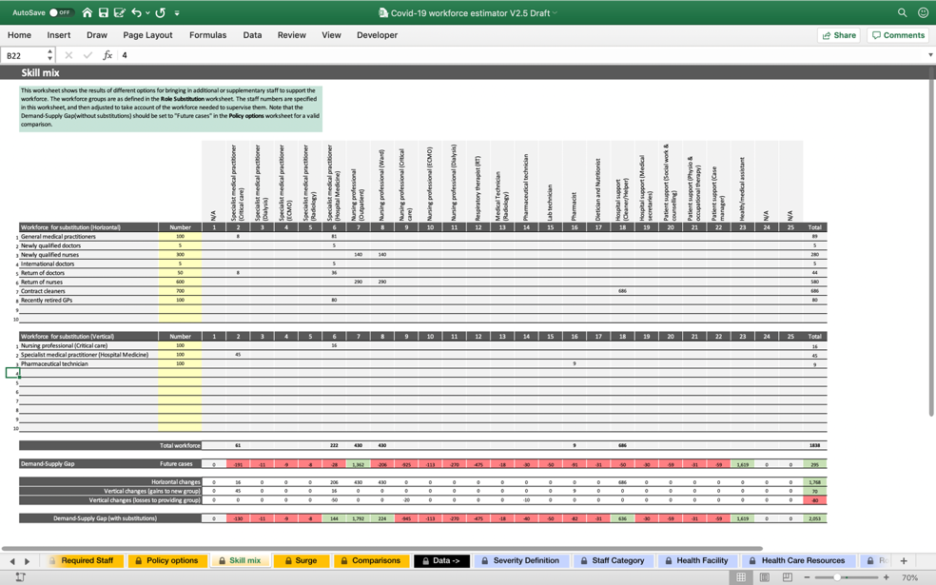
Skill mix worksheet
The Skill mix worksheet helps answer the question:
“What difference can bringing in new staff make, or using existing staff to support colleagues?”
Input the number of staff from outside (horizontal) the system
Input the number of staff from inside (vertical) the system
Check that the Demand-Supply Gap being investigated is correct. The numbers shown are from the Policy options worksheet
The summary rows show the changes
Notes:
Go to the Skill mix worksheet
Check that the Demand-Supply Gap is correct, according to the settings in the Policy options worksheet, This should be set to the required number of future cases. The Skill mix worksheet can then be used to investigate ways of reducing any shortages, or shifting from one group in over-supply to another in under-supply.
Note that for vertical substitution, the workforce group than is supporting another group at at higher level will decrease and the supported level will increase. So if 100 nurses move up to support hospital doctors to cover 20% of their tasks, then nurse numbers will decrease by 20, and hospital doctors increase by 16, taking accounting of supervision.

Slide 18
Future Updates
This version (V3.0) is being released to support Member States in estimating the impact of a COVID-19 surge on health workforces. It is designed to be tailored to suit the local environment and member state context.
It is planned that the tool will be updated and improved through its lifecycle.
Future changes may be implemented following user feedback to augment functionality and improve usability.
Notes:
These updates are not prioritized and will be revised as we get user feedback and requests for change.

Slide 19
Further information
For further information please contact:
scotterc@who.int
If you have ideas for enhancements, or specific requests change, please provide the details to the contact above.

